Slide 1
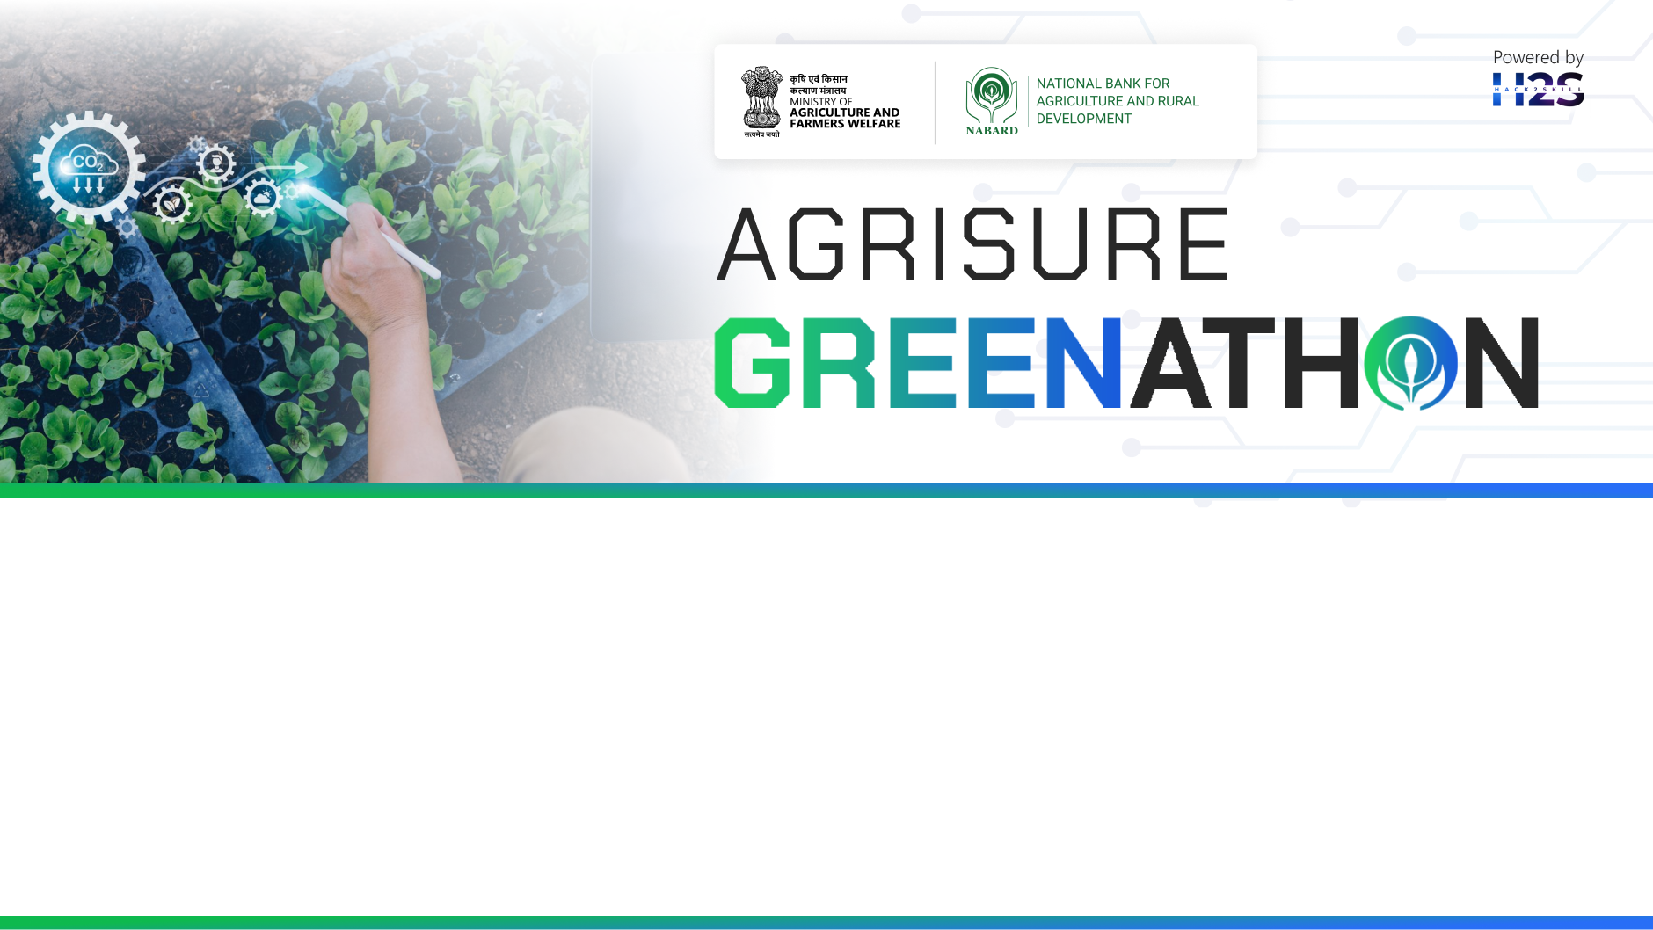
Team Details
Team Name: Agrifusion
Team Leader Name: Ayush Thakur
Problem Statement: Tech Solutions Making Regenerative Agriculture Remunerative

Slide 2
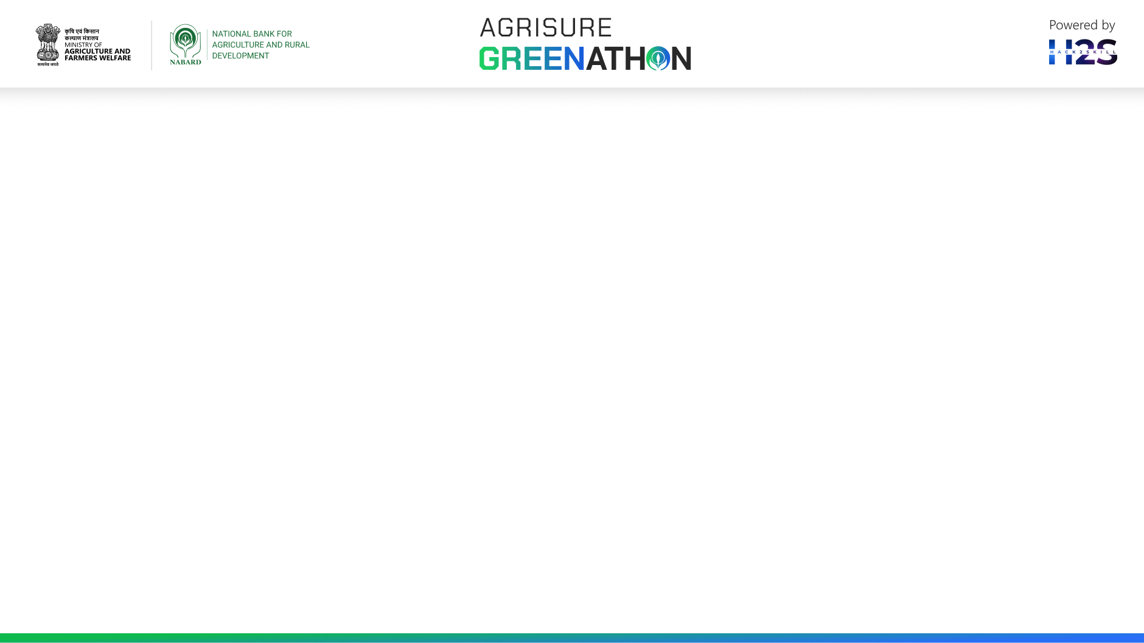
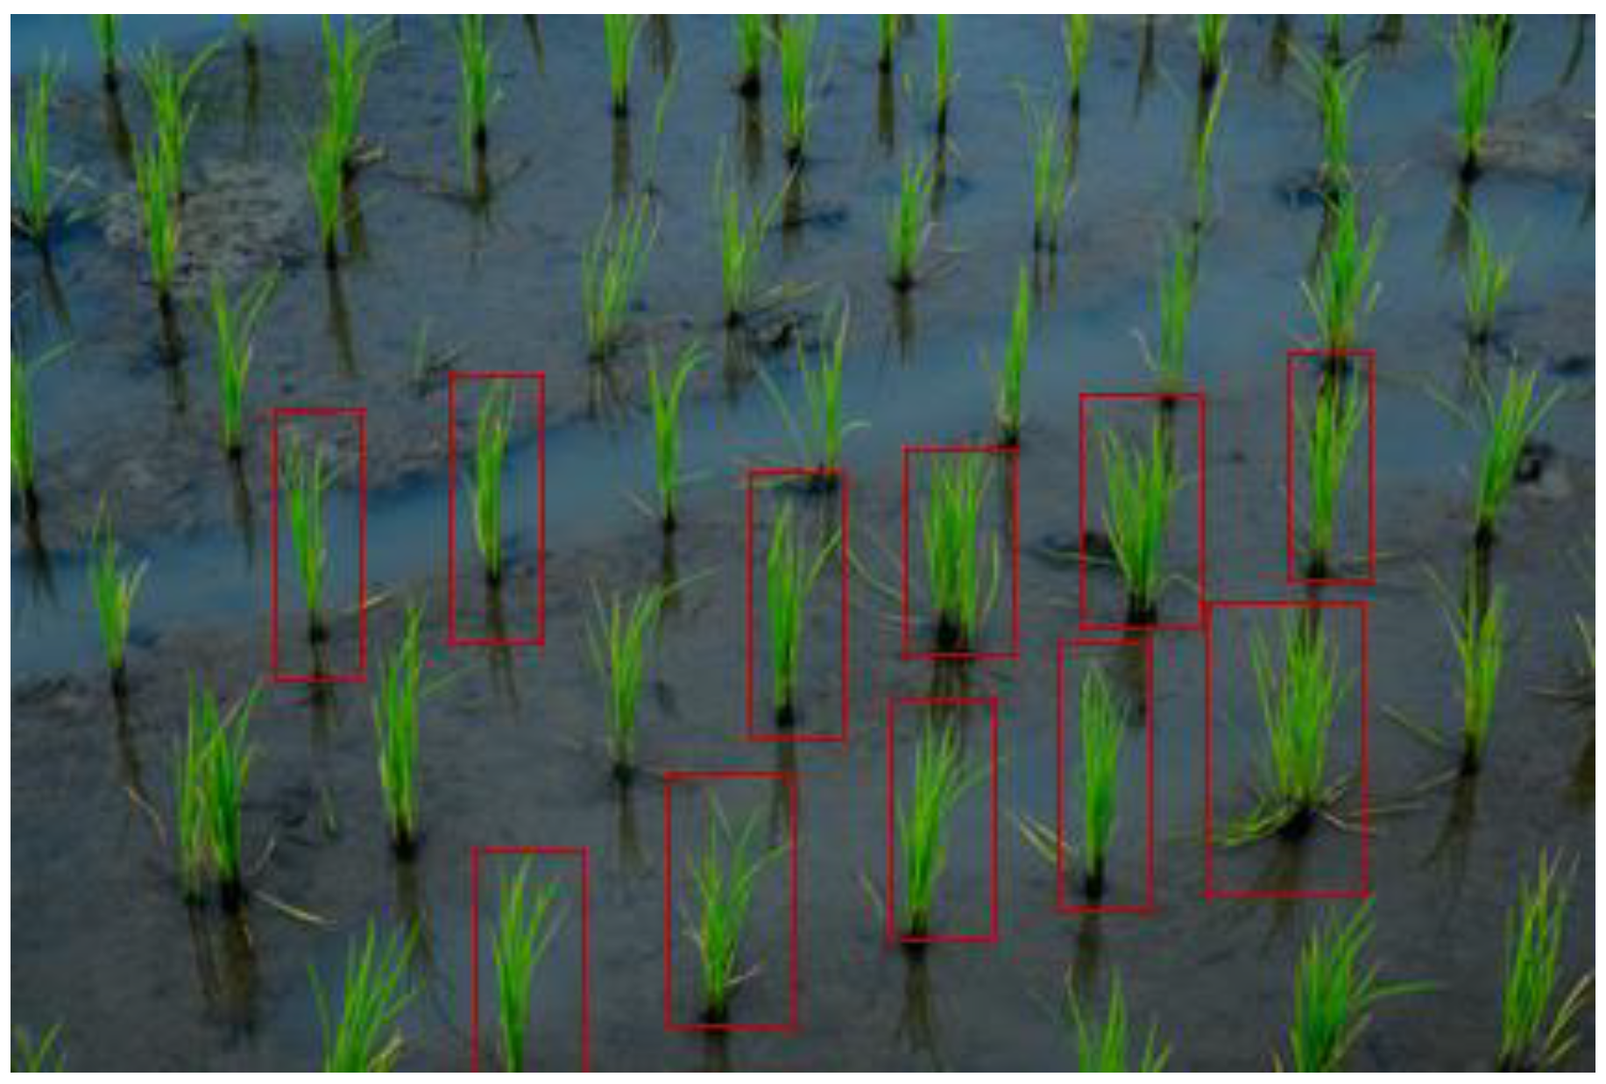
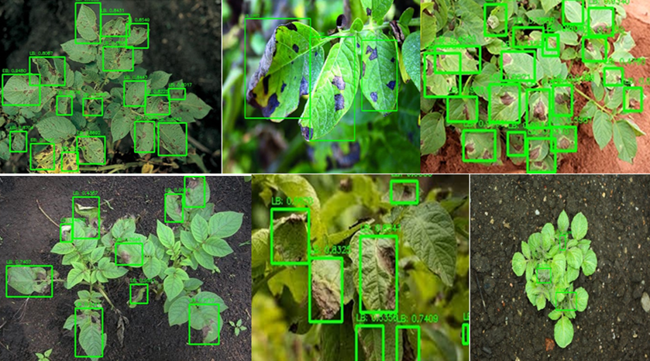

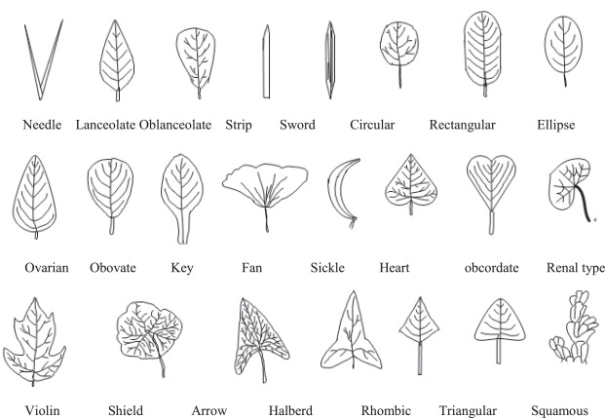
Brief about the idea
To develop an AI-driven system that enhances agricultural practices through automated crop counting, disease detection, soil health assessment, and plant identification.
Fig 1.1
Fig 1.2
Fig 1.3
Fig 1.4
Fig 1.1 Utilizing video frames for detection and counting of crops
Fig 1.2 Analyzing plant images to detect signs of disease.
Fig 1.3 Assessing soil health through various indicators such as moisture levels, nutrient content, and pH balance.
Fig 1.4 Building a comprehensive database of plant textures for accurate identification.

Slide 3
Opportunities
How different is it from any of the other existing ideas?
Table 1.1
Factors | Existing Solutions | Our Solution
Integration of Multiple Functionalities | Often focus on a single aspect, such as crop monitoring or soil health assessment. | Combines multiple functions (crop counting, disease detection, soil health assessment, and plant identification) into a single, comprehensive platform.
Use of Video Frames for Crop Detection and Counting | Typically rely on static images or manual counting methods. | Leverages continuous video frames to provide real-time, accurate crop counting, enhancing monitoring precision and reducing labor.
Advanced Disease Detection | May use basic image recognition for disease detection, often limited to specific diseases. | Employs AI and machine learning algorithms to analyze plant images, detect a wide range of diseases, and provide early warnings and treatment recommendations.

Slide 4
Opportunities
How different is it from any of the other existing ideas?
Table 1.2
Factors | Existing Solutions | Our Solution
Soil Health Assessment | Often focuses on single indicators (e.g., moisture, pH) | Assesses multiple indicators (moisture, nutrients, pH) using IoT sensors and AI for a holistic view.
Plant Texture Database | May have limited databases for plant identification. | Builds a comprehensive, AI-driven database for faster and more accurate plant identification across diverse species.
Analysis | Requires manual input and analysis | Provides automated, real-time analysis and feedback for efficient decision-making.

Slide 5
Opportunities
How will it be able to solve the problem?
Table 1.3
Technology | Implementation | Benefit
Automated Crop Counting | Drones or stationary cameras capture field video. AI algorithms analyze video frames, counting crops in real-time and updating records continuously. | Saves time and labour compared to manual counting. Provides accurate and up-to-date crop stand data.
Disease Detection | Farmers upload images of plants. System analyzes images for disease symptoms using image recognition and machine learning. Compares analysis to a disease database and suggests treatment options. | Early detection of plant diseases, allowing for prompt action and minimizing crop damage. Improved decision-making regarding treatment strategies.
Soil Health Assessment | Sensors placed in the soil measure moisture, nutrient levels, and pH data. AI analyzes sensor data to provide actionable insights and recommendations for soil management. | Comprehensive understanding of soil health conditions. Optimizes resource use (water, fertilizer) based on real-time data.
Plant Identification | Farmers capture images of unknown plants. AI and machine learning algorithms match images against a comprehensive plant texture database for accurate identification. | Efficient identification of plants, including weeds and beneficial species. Improved knowledge of field conditions for better management decisions.

Slide 6
Opportunities
USP of the proposed solution
All-in-One Integrated Platform
Real-Time Video-Based Crop Monitoring
Advanced AI-Driven Disease Detection
Comprehensive Soil Health Analysis
Extensive Plant Texture Database
User-Friendly and Automated Data-Driven Decision Making
Scalability and Adaptability

Slide 7
List of features offered by the solution
Automated Crop Counting:
Utilizing video frames to detect and count crops by identifying blue dots representing plants . Each detected blue dot increments the crop count.
Disease Detection:
Analyzing plant images to detect signs of disease. Implementing machine learning algorithms for early and accurate disease diagnosis.
Soil Health Assessment:
Assessing soil health through various indicators such as moisture levels, nutrient content, and pH balance . Providing actionable insights to farmers for optimal soil management.
Plant Identification Based on Leaf Texture:
Using image processing techniques to identify plants based on the unique texture of their leaves . Building a comprehensive database of plant textures for accurate identification.

Slide 8
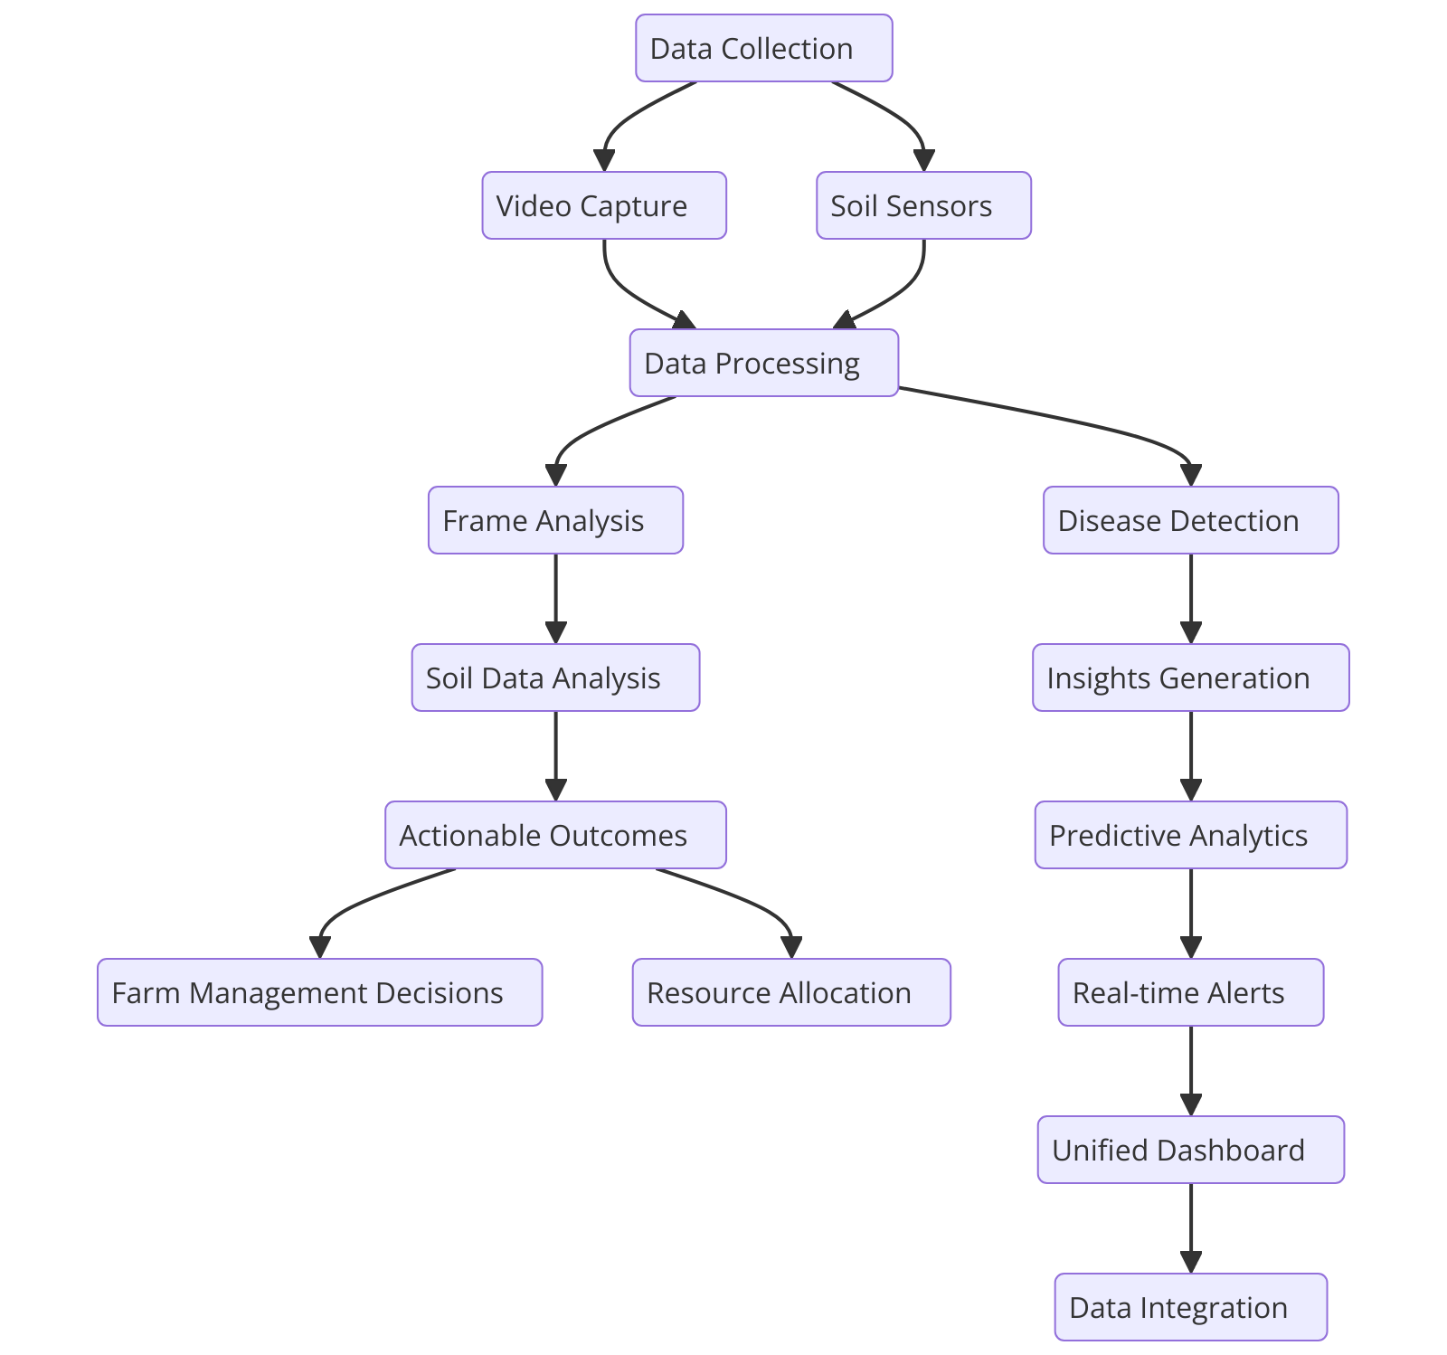
Process flow diagram or Use-case diagram
Fig. 1.5

Slide 9
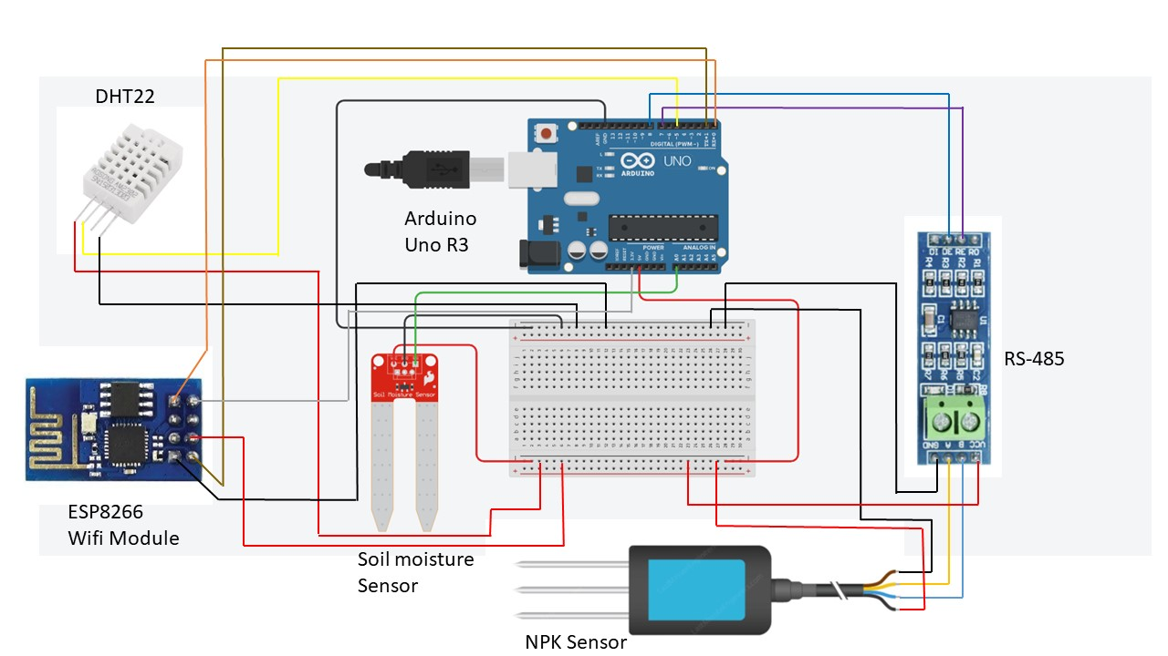
Wireframes/Mock diagrams of the proposed solution (optional)
Fig. 1.6: Basic Layout of System sensors for testing soil health

Slide 10
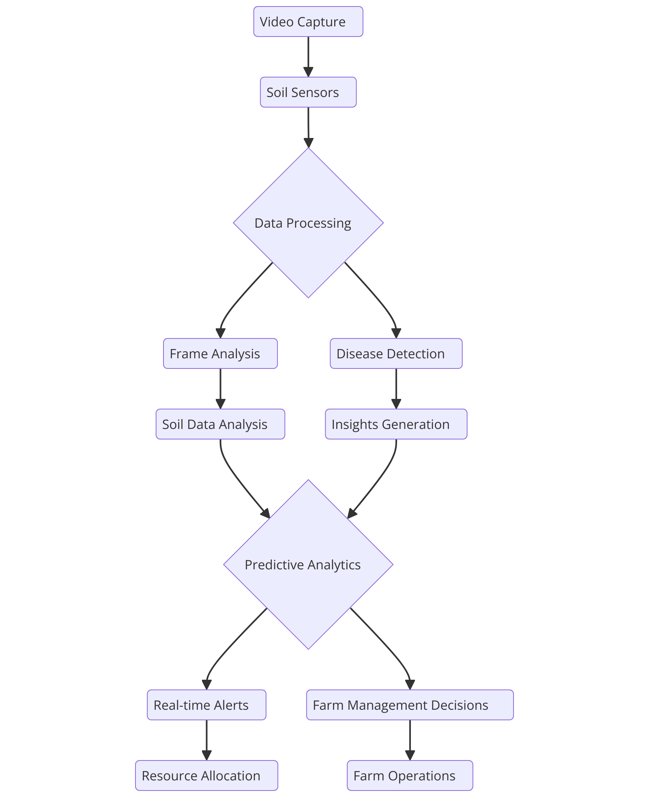
Architecture diagram of the proposed solution
Fig. 1.7

Slide 11



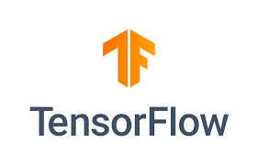

Technologies to be used in the solution

Slide 12
Estimated implementation cost (optional)
The project is integration of both software and hardware.
For software:-
we are using open source free softwares like pytorch , yolo , python , tensor flow and etc
For Hardware:-
We are using
SNo | Component | Price (INR)
1 | Arduino Uno | ₹820 - ₹2,050
2 | ESP8266 WiFi Module | ₹410 - ₹820
3 | NPK Sensor | ₹2,050 - ₹4,100
4 | Soil Moisture Sensor | ₹164 - ₹820
5 | DHT22 (Temperature and Humidity Sensor) | ₹410 - ₹820
6 | RS-485 Module | ₹410 - ₹1,230
Total |  | ₹4,264 - ₹9,840

Slide 13


